Slide 1
Product ArchitecturE
Max, Louis, Lukas, Christopher

Slide 2
Overall Architecture
Android Material Design UI
Application Code
Android OS
SQLite DB

Slide 3
System Boundaries
Pocket Chef
Add/Edit Recipe
Delete Recipe
Search Recipe
Edit Recipe
Backup/Restore Database

Slide 4
Context Model
«system»
Pocket Chef
«system»
SQLite Database
«system»
IO for Recipe DB Backup

Slide 5
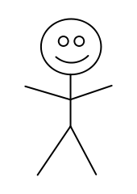
Use Case 1
Search
Recipe
View
Recipe

Slide 6
Use Case 2
Add
Recipe
Edit
Recipe
View
Recipe
Recipe
Data Base
User
Delete
Recipe

Slide 7
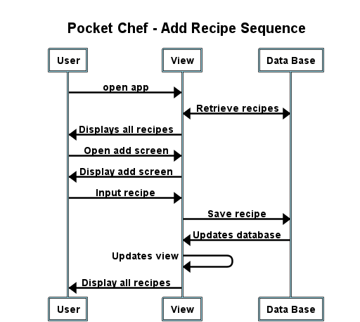
Add Recipe Sequence Diagram

Slide 8
Activity Diagram
User find recipe
User inputs / changes search parameters
Data base displays filters recipes
View Recipe
Recipe does not exist
User does not find recipe
Main View

Slide 9
State Diagram
View
Recipe
Recipe
View
Edit Recipe
Edit
Recipe View
Delete Recipe
View
Recipe
Exit
Recipe
Edit Recipe
Search Screen
Delete Confirmation
Opening Screen
Save Recipe
or Cancel
Delete
Recipe
Add Recipe
Recipe
Search
Add
Recipe View
Exit Search

Slide 10
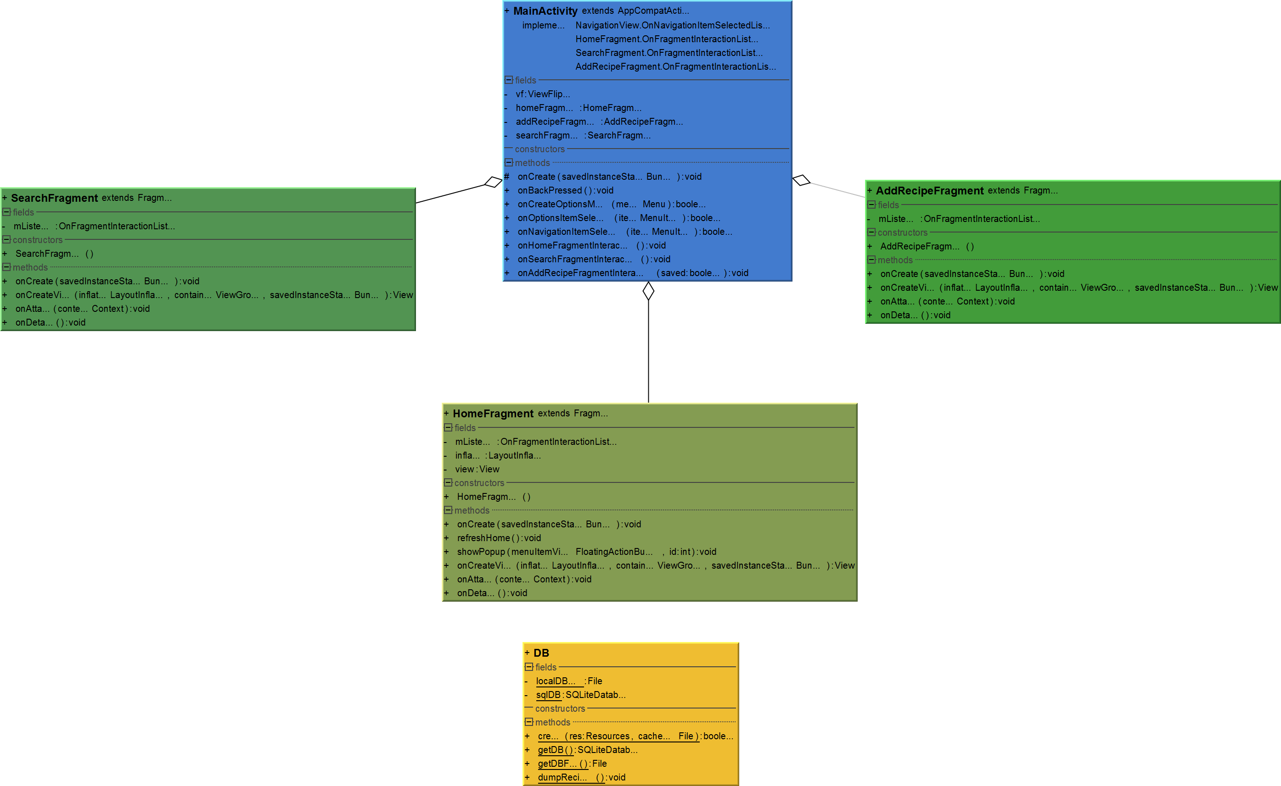
Simple Code Class Diagram

Slide 11
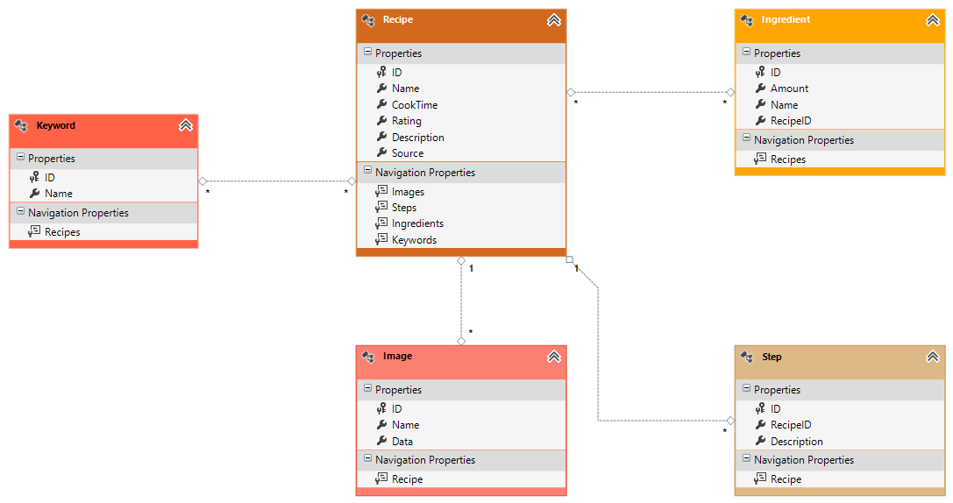
Database Class Diagram

